Slide 1

NMC Medical Conditions
Date: 03 October 2022
Venue: PRF Lecture Hall

Slide 2

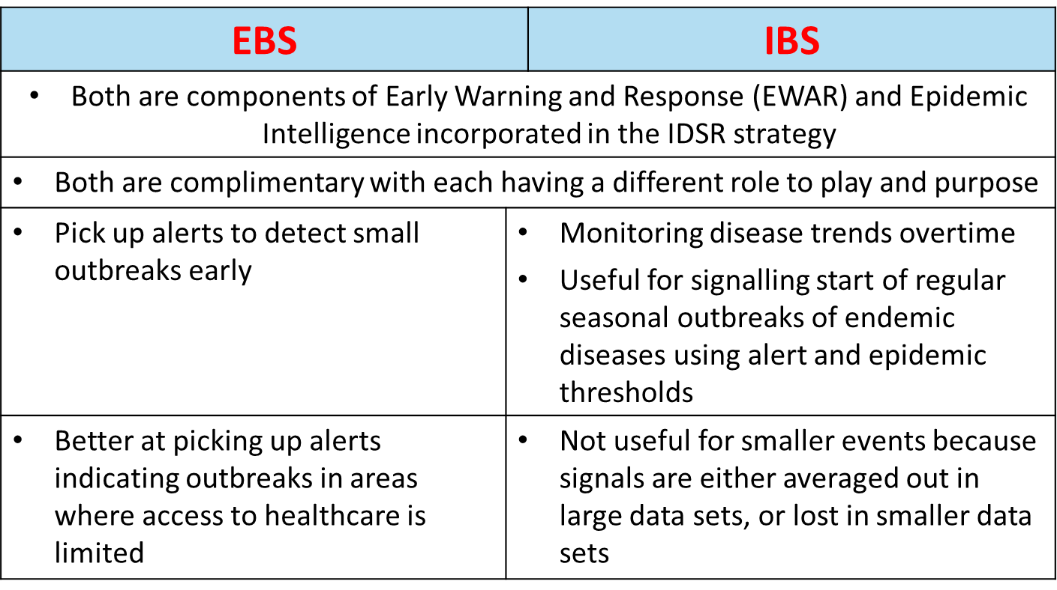
Public Health Surveillance
Is the ongoing systematic identification, collection, collation, analysis, and interpretation of disease occurrence and public health event data to take timely and robust action
Passive versus Active
Indicator based versus Event based
Notes:
Facility based, Laboratory based, Disease specific, Case based, Syndromic, Community based…

Slide 3


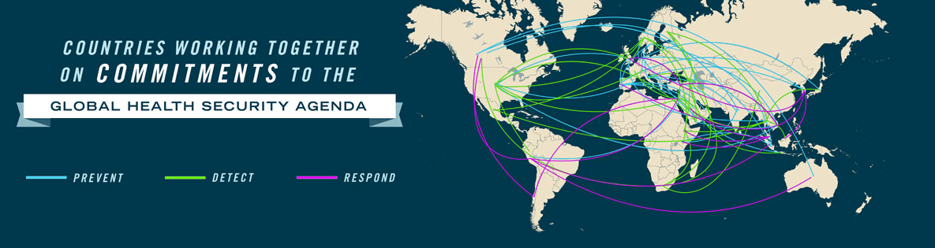
IHR and Notifiable Medical Conditions
“to prevent, protect against, control and provide a public health response to the international spread of disease in ways that are commensurate with and restricted to public health risks, avoiding unnecessary interference with international traffic and trade.”
Through the IHR, countries agreed to build national surveillance and response systems with capacities to detect, assess, notify and report any public health emergency of international concern.
includes specific measures at points of entry (PoE) such as ports, airports and ground crossings to limit the spread of health risks to neighbouring countries.
PREVENT
DETECT & REPORT
RESPOND

Slide 4
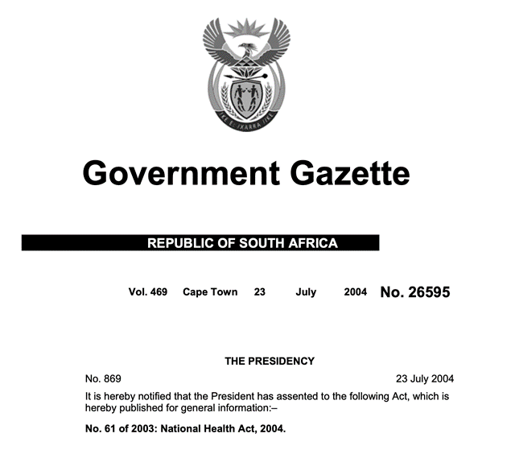
Legislation for Notifiable Medical Conditions in South Africa
The National Health Act, 61 of 2003 in South Africa
strategy for the prevention and control of epidemic prone diseases
Regulations Relating to the Surveillance and the Control of Notifiable Medical Conditions, 2017
Legal requirement for laboratories to notify
Duty to investigate when cases have not presented to health care providers
Include redundancy in category 1 definition to include new threats as proclaimed by the Minister of Health (e.g in 1993, it was only after 800,000 people had died that it was considered a “genocide”; requirement to gazette may not be timely)
Currently under review >250,000 comments submitted

Slide 5
History of NMC reporting in SA
Established in 2015
Memorandum of understanding between NDoH
Paper Based
Before 2015 NMC surveillance was mainly paper-based
In 2017, new standard NMC case notification was developed and published
App development
NMC App was developed and piloted in 2017;
It was officially launched in April 2018;
5 out of 9 provinces officially launched the App
COVID-19
New App

Slide 6
History of NMC reporting in SA
2016
- Assessment of the current notification processes and channels to identify bottlenecks and learn from best practice
- Development of new tools for paper based reporting
- Piloting of tools
2017
- New enhanced paper based NMC reporting
. new NMC case notification form
. Case definitions
. Standard operating procedures and user manuals
- Development & piloting of new NMC APP
- Revision of NMC Regulations
- Private labs and Med schemes - planning
2018
- 9 NMC nurse trainers recruited
- Training of Public and Private Sector users
- National phased-out roll out of NMC APP
- Web based and mobile platforms for real-time electronic reporting at point of diagnosis
-Inclusion of dashboards and reports
- Enhancement of laboratory based reporting of NMCs
2019
- Strengthening data collection and integrity
- Engage NICD centres for epidemiological classification of cases
- Review of case definitions
-Improvement of data flows and harmonization
- Development of CIFs and outbreak management tools
-Ongoing engagement of private laboratories and medical schemes

Slide 7
History of NMC reporting in SA
2020
- COVID-19 notification Module
- Development of an improved NMC Application
- NMC line list COVID-19
2021-2022
- Launch of the improved NMCSS electronic application
- Development of CIFs
-Strengthen data quality

Slide 8
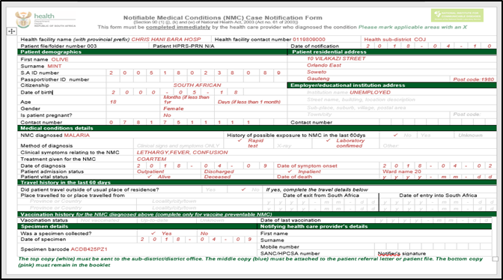
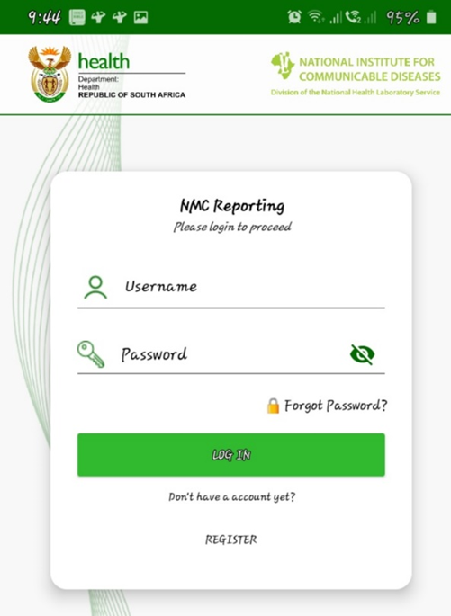

Notification platforms

Slide 9
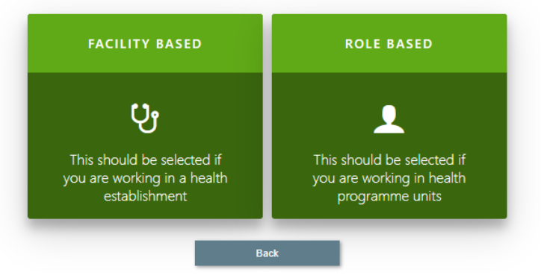
NMC Users
Health facility based
Role based
Public facility
Private facility
National
Province
District
Sub-district

Slide 10
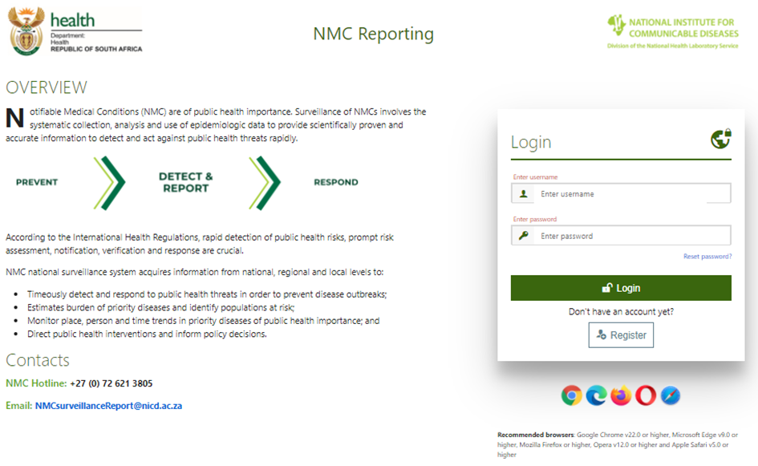
NMC Reporting App- web based platform

Slide 11
NMC categories
Category 1 - within 24 hours of diagnosis by healthcare providers (22 conditions)
Notified based on clinical suspicion
Telephonic report to local or district authority
Completion of NMC case notification form
Category 2 - within 7 days of diagnosis by healthcare providers (21 conditions)
Notified upon receipt of a laboratory confirmation
Completion of NMC case notification form
Category 3 - within 7 days of diagnosis by private and public health laboratories (7 conditions)
Category 4 - within 1 month of diagnosis by private and public health laboratories (4 conditions)

Slide 12
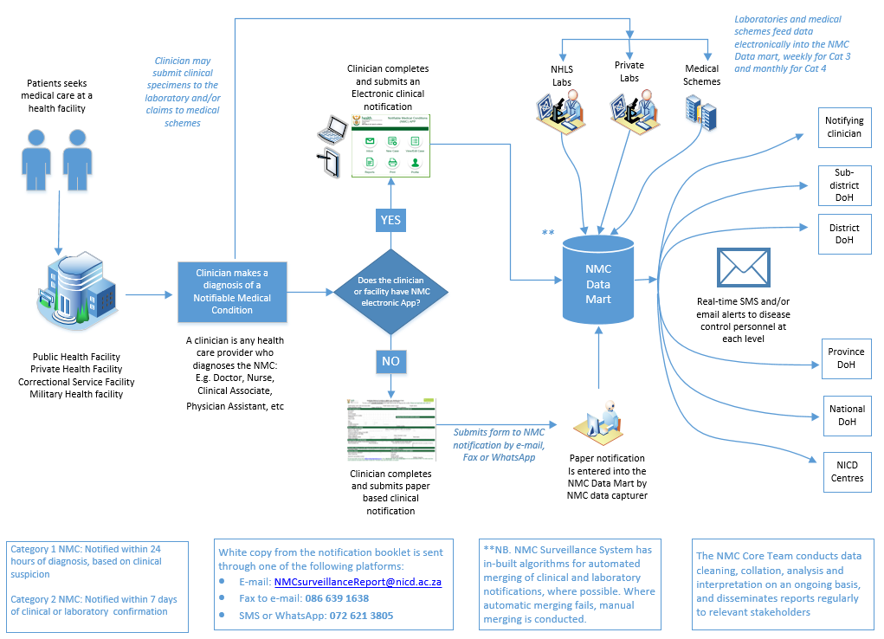
NMC Surveillance Data Flow and Communication

Slide 13

A day in a life of a Infection Control Nurse with the NMC Reporting App
Surveillance flow
Infection Control Nurse
NMCSS
Cat 1: SMS Alerts
Lab
Testing
Isolation
Referral
NICD for further testing
Pheno-/genotyping
Local Hospital Database
Data management
Improved local reporting
Hospital
Patient admitted
Specimen taken
Cat 2: In your App
Benefits
NMCSS integrated to TrakCare (NHLS)
Follow up a known confirmed specimen in lab
Create relationships with lab staff
Improved completeness
Facility name provided
Locate and interview patient in near real-time
SMS alerts on suspicion and confirmation
Improved follow up rates

Slide 14
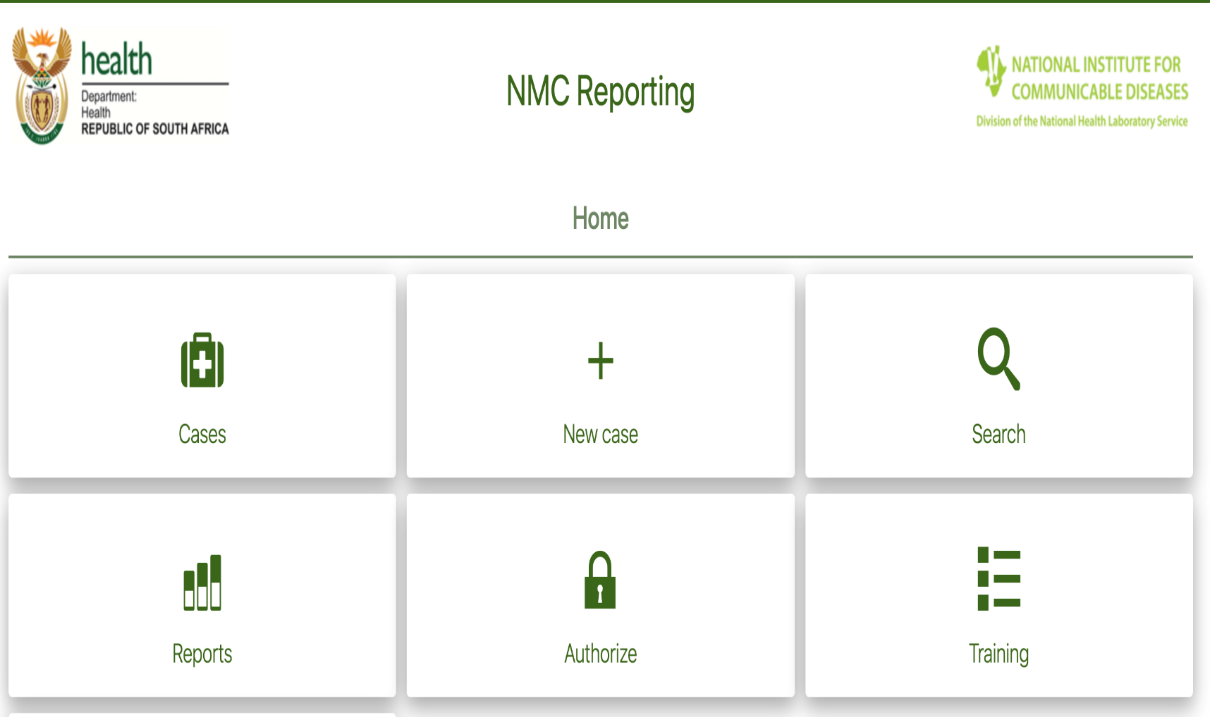

There is more:- NMC Functions to boost daily activities

Slide 16
Looking for cases notified by linked facilities

Slide 17
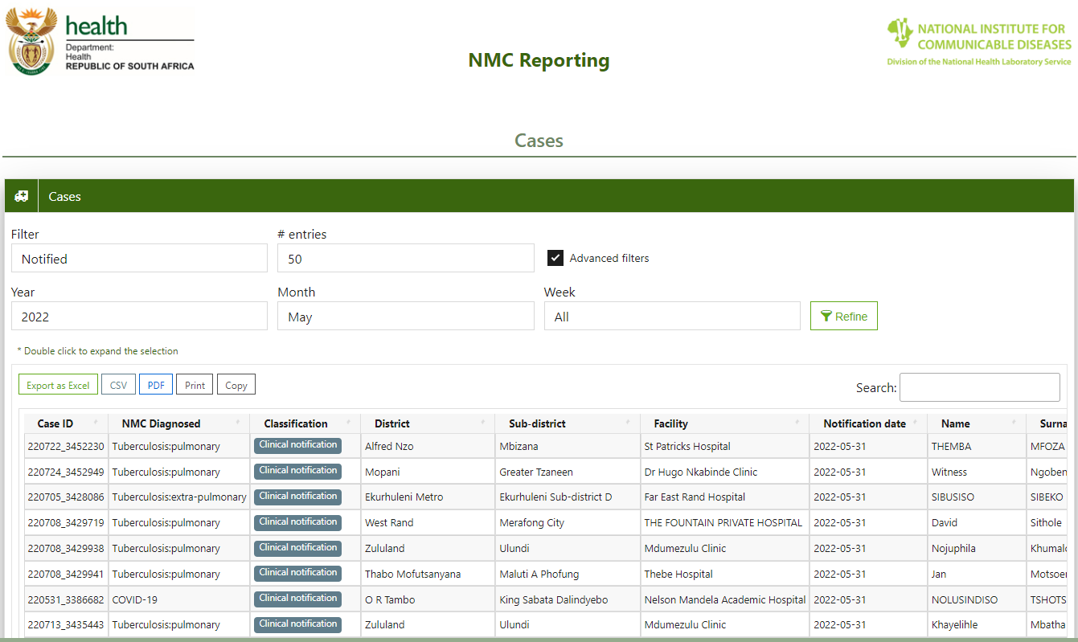

Slide 18
There is more:- NMC Functions to boost daily activities

Slide 19
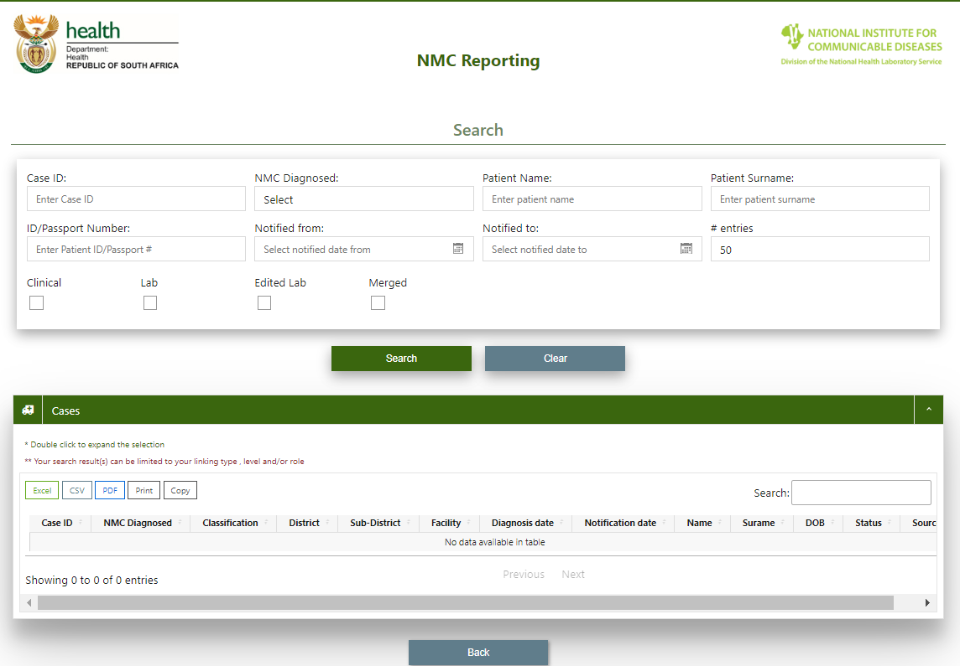
Advanced search

Slide 20
Limitations and way forward
Current Limitations
Low clinical notification rates and low uptake in some provinces
Dual reporting systems
User can only link to maximum of five facilities within a province
Additional facilities requested with motivation
System access matrix does not allow cross province and cross NICD Centre linkage
NMC Matrix review

Slide 21



NMC reengineering
To develop an integrated, efficient and real-time national NMC surveillance system that enables timely data collection, collation, analyses and dissemination for effective public health action
Create window of opportunity for rapid detection and response
Platform for efficient communication of information for action
Enable timely and coordinated follow-up on required clinical, laboratory and public health procedures

Slide 22
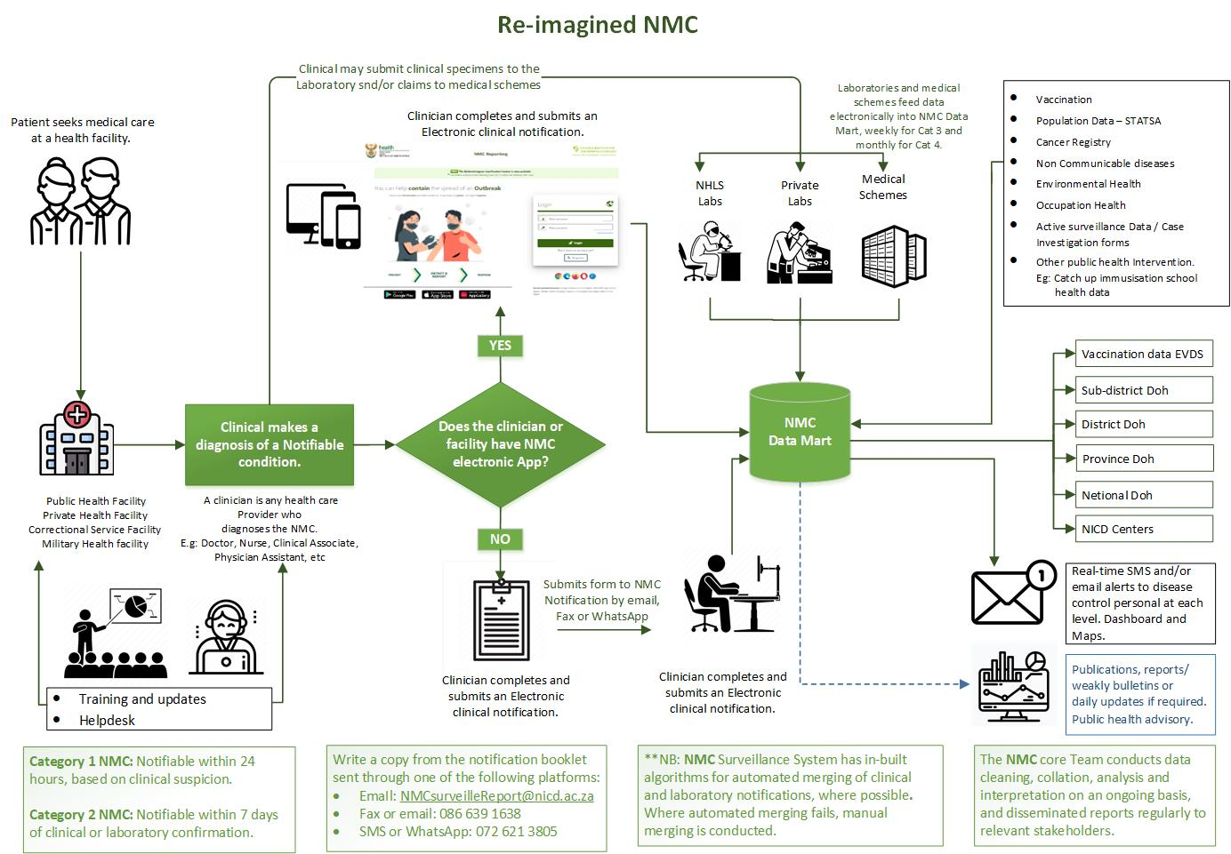
Rethinking NMC Surveillance Data Flow and Communication

Slide 23
NMC improvements
Interactive NMC App
Chat-box approach
Communication when server is down or during maintenance
E.g. SMS alerts (benchmark on banks)
Feedback to user
- Dashboards –filter according to user needs (interactive)
- Epidemiological classified cases –MMWR
- Public health Response outcome
Stable and flexible system
Interoperable system for integration

Slide 24

Thank you
NMC’s hotline number: 072 621 3805

